Slide 1
“ The Cocktail Party” (1967) Ôshiro Tatsuhiro (1925-2020)
カクテル・パーテイー
大城立裕

Slide 2
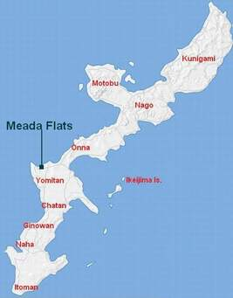
Map of Okinawa

Slide 3
Keywords
Novella: Akutagawa Prize, 1967
Play: staged 2011
Film: released 2015, dir. Regge Life
US-Japan Joint Mutual Security Treaty (Anpo), 1954, 1960-today
Status of Forces Agreement (SOFA)
Sato-Nixon accord, 1969
Narration
Symbol
Allegory

Slide 4
Discussion Questions
Analyze the story’s narration. Is it consistent throughout? Why/not?
The story returns frequently to an event that took place ten years prior to the narrative present when the protagonist got lost. Why?
Who is the victim in the story? Why?
What, if anything, is significant about the landscape painting in Mr. Sun’s home?
What are the strengths and weaknesses of the film adaptation of The Cocktail Party?

